Slide 1


CISC3024 Presentation Victor MAI 麦家俊 D-C1-2784-3
Presentation

Slide 2
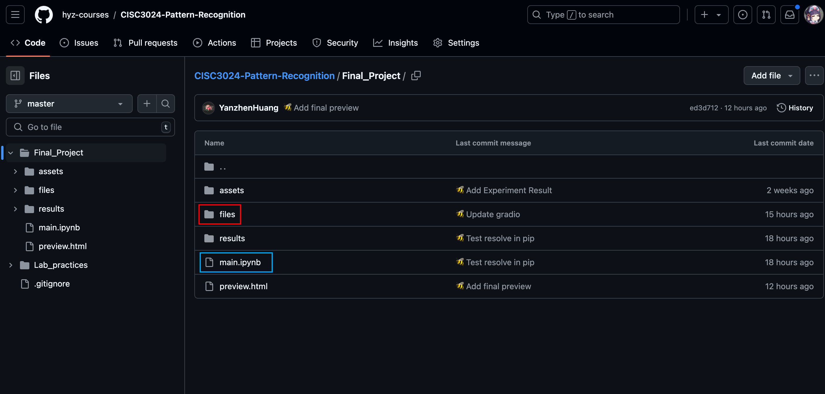
0 GitHub repo website
Repo Root: https://github.com/hyz-courses/CISC3024-Pattern-Recognition/tree/master
❏ ipynb Source file: https://github.com/hyz-courses/CISC3024-Pattern-Recognition/blob/master/Final_Project/main.ipynb
❏ PDF Preview: https://github.com/hyz-courses/CISC3024-Pattern-Recognition/blob/master/Final_Project/preview.html

Slide 3
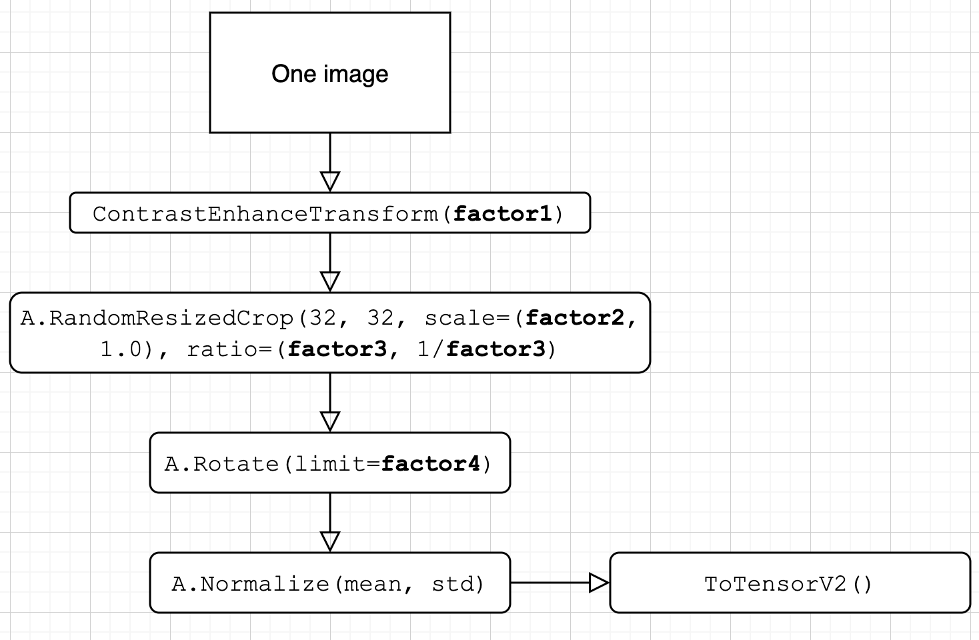

1 Data Processing and Augmentation
1.1 Transforms used on images
Determined transform steps after brainstorming.

Slide 4
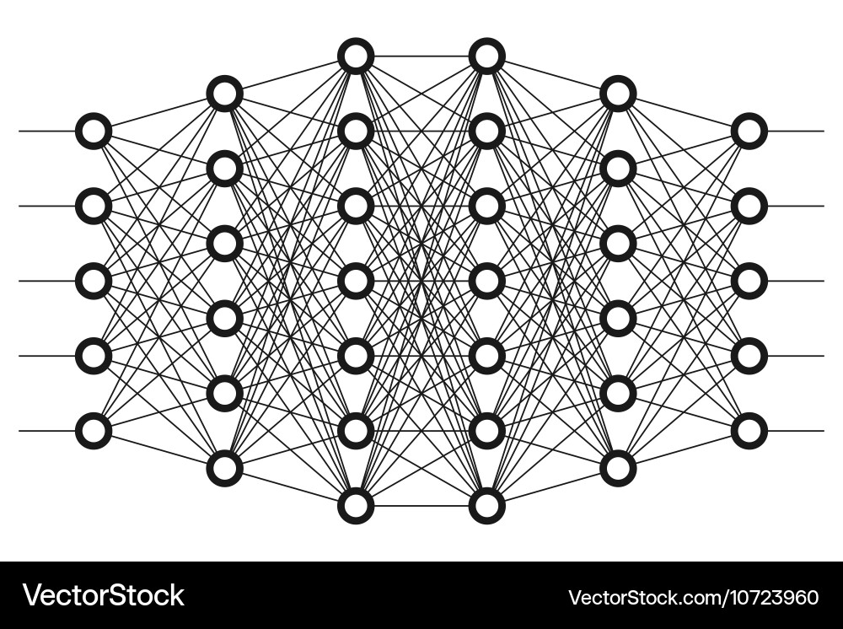
2 Neural Network Setup
In this project, we will design a simplified VGG model, named SmallVGG, which will replicate the convolutional and fully connected layers of the traditional VGG architecture.
In Experiment 4-1, we will also explore neural networks beyond VGG to satisfy our curiosity about different architectures and conduct analyses.

Slide 5
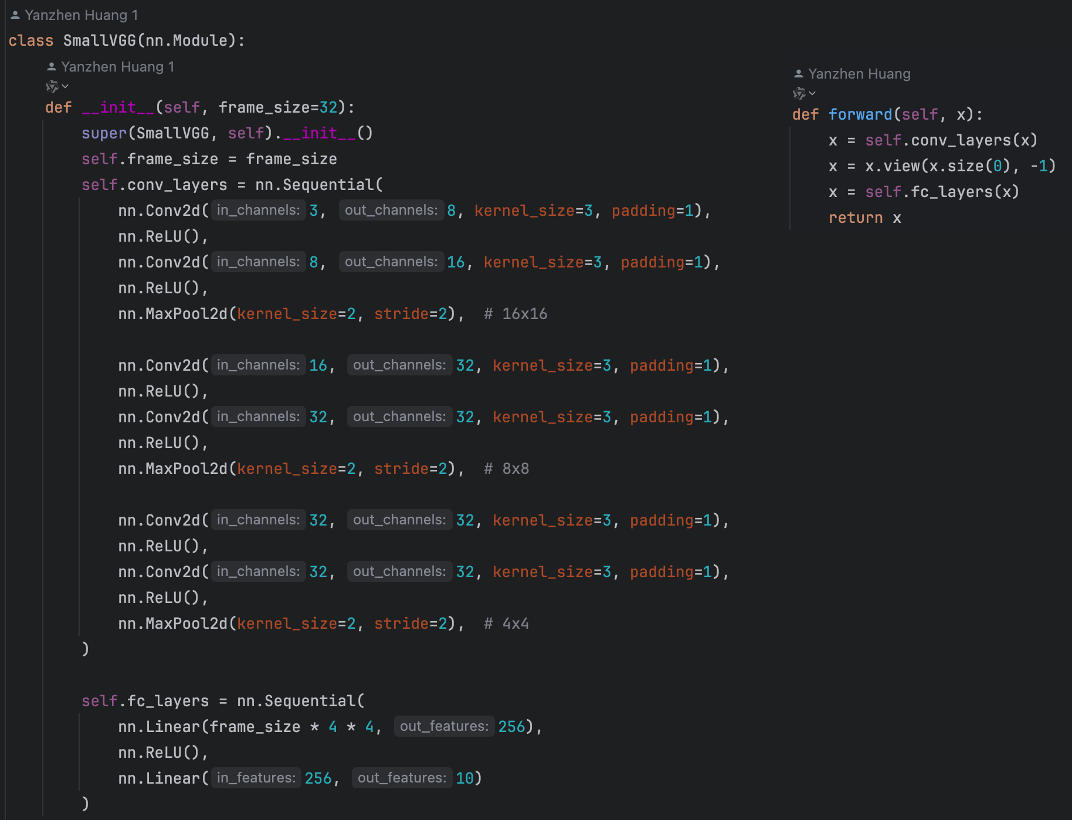
2 Neural Network Setup
2.1 class SmallVGG(nn.Module):
This neural network undergoes 3 times (convolution*2 + pooling*1) operations,
and then flattens the multi-dimensional data into one-dimensional data before entering the fully connected layer.

Slide 6

3 Coding Training and Evaluation Functions
In this section, we will experiment with different parameter combinations and analyze the comparative results. We will use a simple grid search to identify the parameter combinations worth retaining.
Try to perform validation after each experiment and compute the Receiver Operating Characteristic (ROC) curves and Area Under the Curve (AUC) and Confusion metrics.

Slide 7

3 Coding Training and Evaluation Functions
3.1 Hyperparameters:
Experiment Set 1 (Optimizer): Attempting to find an optimal optimizer.
Experiment Set 2 (Epoch, Learning Rate, Batch Size): Aiming to find suitable values for the number of epochs and learning rate, and to determine the appropriate batch size for the project.
Experiment Set 3 (Transform Hyperparameters): Appropriate image transformations can enhance the model’s fitting ability, but excessive transformations can lead to underfitting.
Experiment Set 4 (Additional Experiments): Using models other than VGG, including LeNet-5, AlexNet, and GoogLeNet.

Slide 8
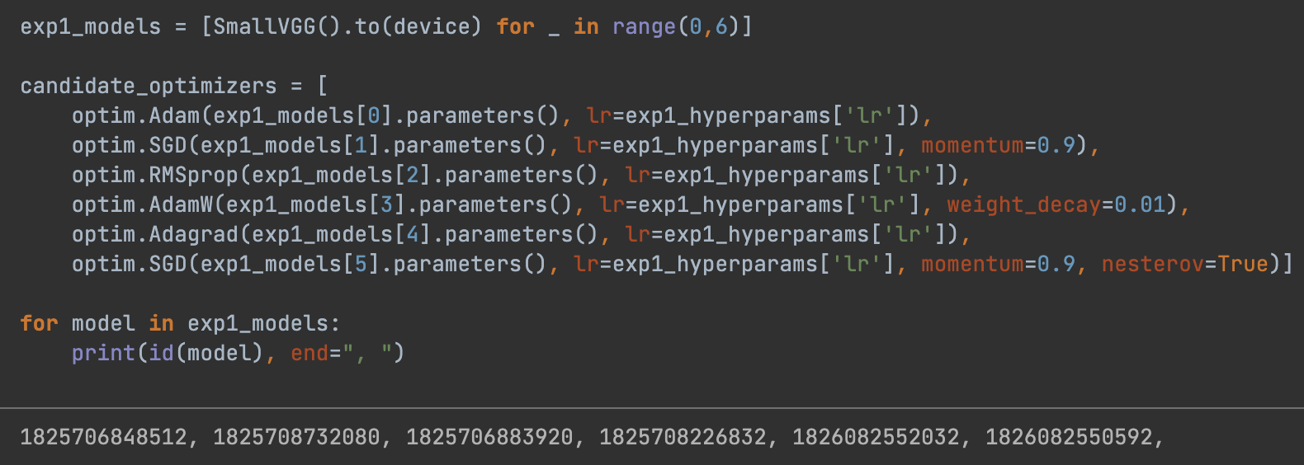
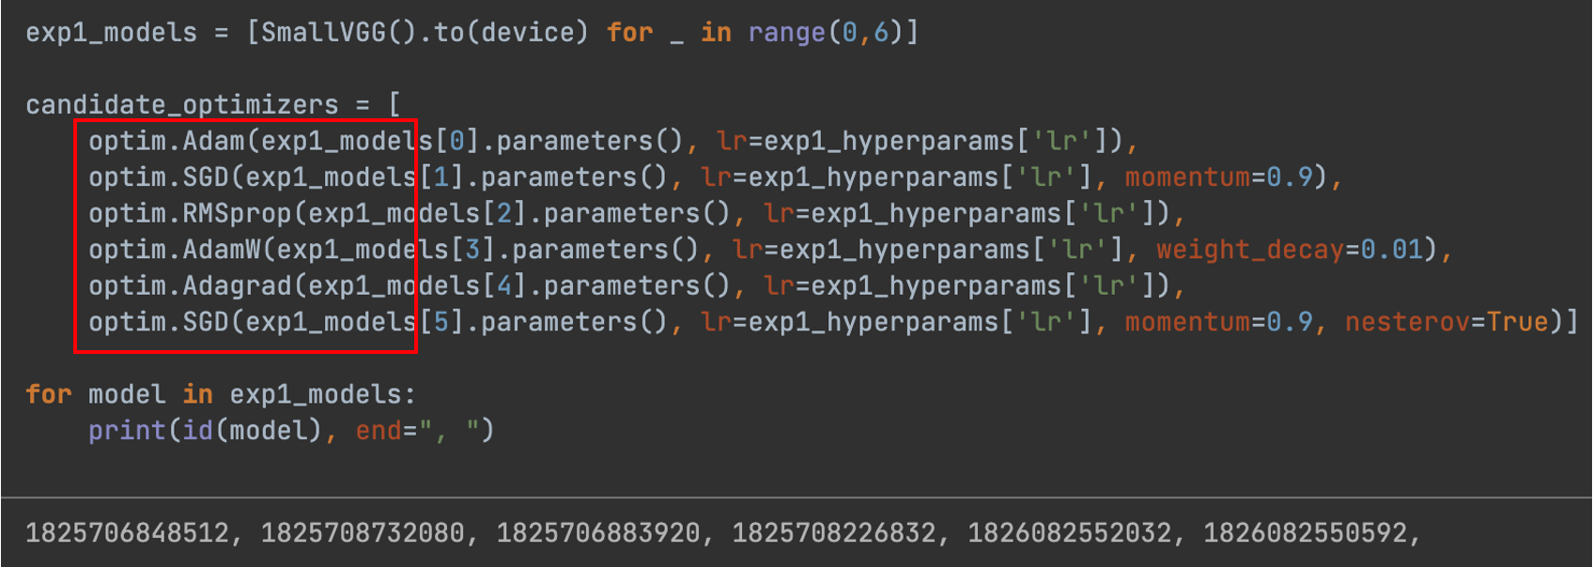
3 Coding Training and Evaluation Functions
3.1 Experiment 1(Optimizer) :
We identified 6 different optimizers suitable for image processing (as shown in the figure below)

Slide 9
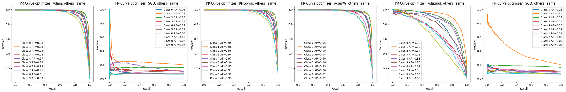
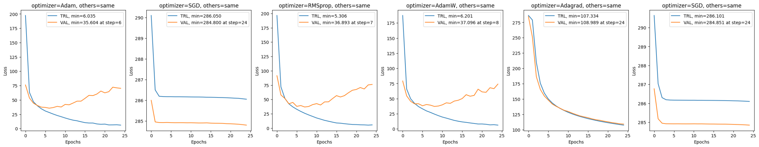
3 Coding Training and Evaluation Functions
3.1 Experiment 1(Optimizer) :
Figure 3.1.1: Precision-Recall Curve of different optimizers
Figure 3.1.2: Train loss – valid loss graph of different optimizers

Slide 10
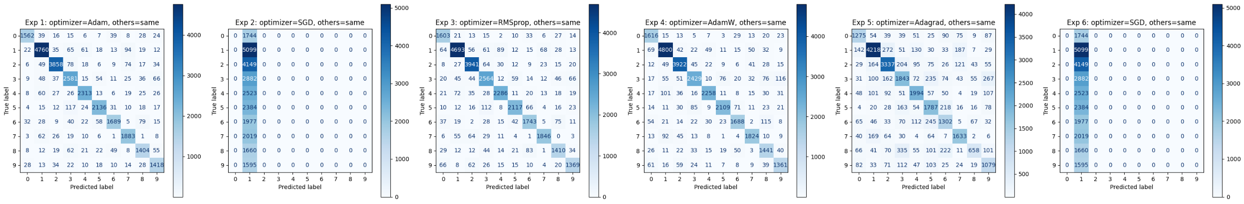
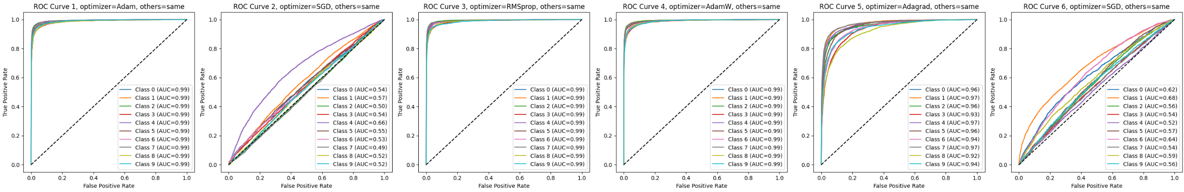
3 Coding Training and Evaluation Functions
3.1 Experiment 1(Optimizer) :
Figure 3.1.3: Confusion Matrix of different optimizers
s
Figure 3.1.4: ROC-AUC Curve (Micro) of different optimizers

Slide 11
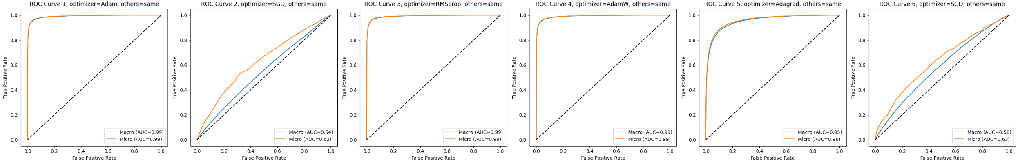
3 Coding Training and Evaluation Functions
3.1 Experiment 1(Optimizer) :
Figure 3.1.5: ROC-AUC Curve (Macro) of different optimizers
s
Result:
Optimizer “Adam” has the highest avg F1 score: 0.899.
We can find that all optimizers are not good at classify number ‘8’ correctly.

Slide 12
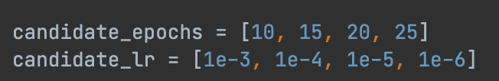
3 Coding Training and Evaluation Functions
3.2 Experiment 2-1(Epoch, Learning Rate):
To enable the neural network to fit faster without fluctuations in loss, we prioritize performing a grid search on both the epoch and learning rate together. (in other words: 4 x 4 = 16 sub-experiments)

Slide 13
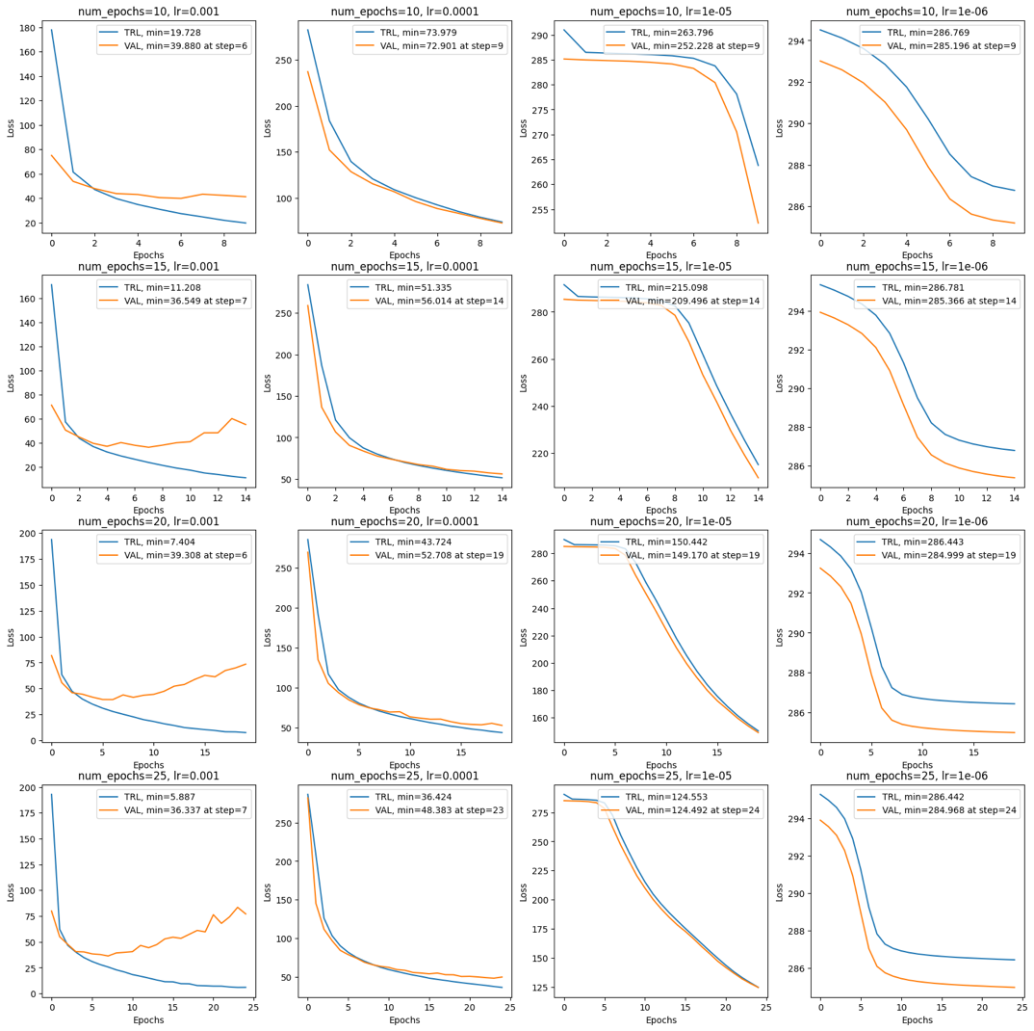
3 Coding Training and Evaluation Functions
3.2 Experiment 2-1(Epoch, Learning Rate):
Result:
Combination “Epoch = 15” and “lr = 1e-3” has the highest avg F1 score: 0.909.
However, the issue is that we cannot confirm that this combination is optimal because it is located at the upper right corner of the grid search. Therefore, we plan to further investigate the optimal value of the learning rate.

Slide 14
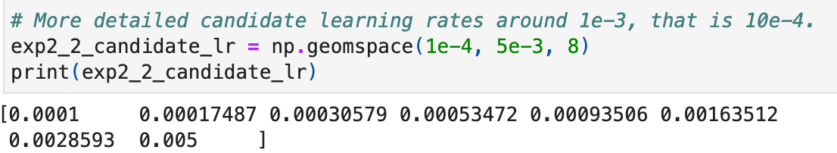
3 Coding Training and Evaluation Functions
3.3 Experiment 2-2(Deeper on Learning Rate):
We will experiment with determining the learning rate in a proportional range from 5e-3 to 1e-4, while keeping the epoch fixed at 15.
Figure 3.3.1: Precision-Recall Curve of different optimizers

Slide 15
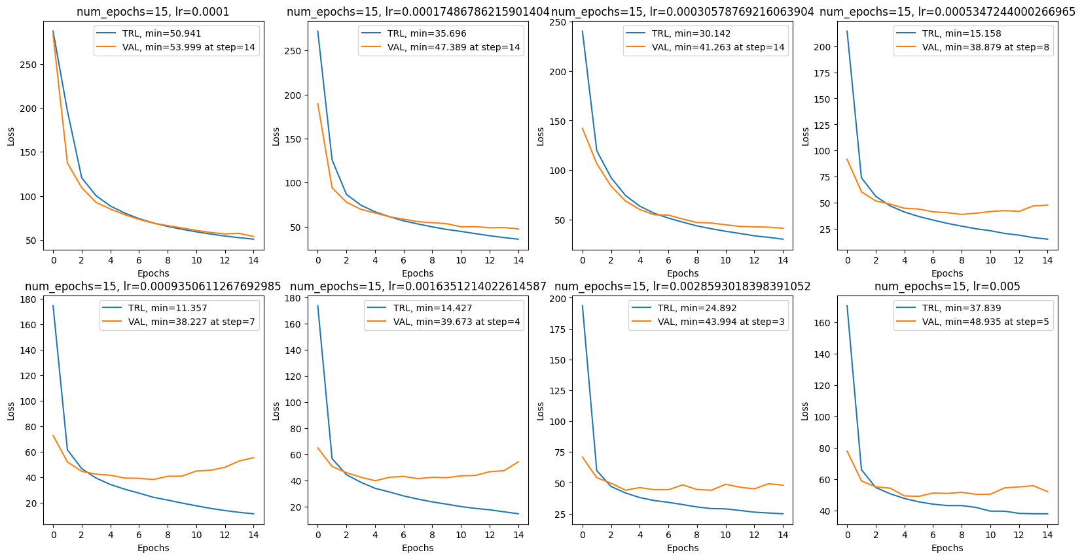
3 Coding Training and Evaluation Functions
3.3 Experiment 2-2(Deeper on Learning Rate):
Result:
It is obvious that “lr = 0.000935” performs way better than others, it has the highest avg F1 score: 0.905 in the Precision-Recall check.
So, we decided to choose “lr = 0.001”.
We found the fact that when the learning rate is reduced by an order of magnitude, the number of epochs required for the model to fit will increase by approximately an order of magnitude, too.

Slide 16
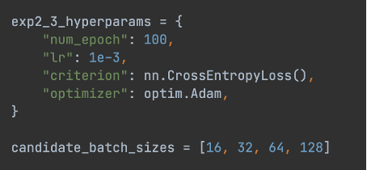

3 Coding Training and Evaluation Functions
3.4 Experiment 2-3(Batch_size):
batch
Figure 3.4.1: hyper Param and candidates of batch size.

Slide 17
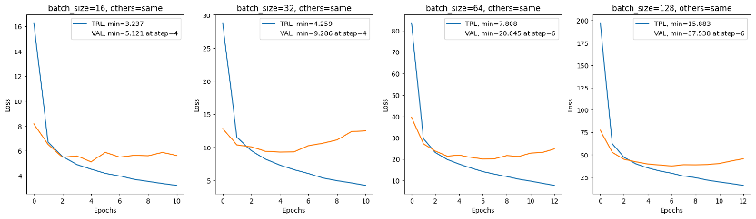
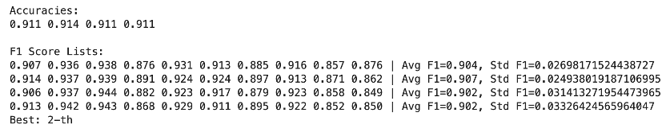
3 Coding Training and Evaluation Functions
3.4 Experiment 2-3(Batch_size):
Figure 3.4.2: Train loss – valid loss graph of 4 kinds of batch size
Result:
This time, 4 different of batch size didn’t pull ahead. In later tests, their scores were also very close in each aspect.
After discussion, we gave the reason that it was the large amount of input data and the optimization of the GPU in computer that led the batch size less active in all result.
We choose “batch_size = 128” as it can speed up a little bit in the experiments later.
Figure 3.4.3: Accuracies and F1 scores for 4 kinds of batch size

Slide 18
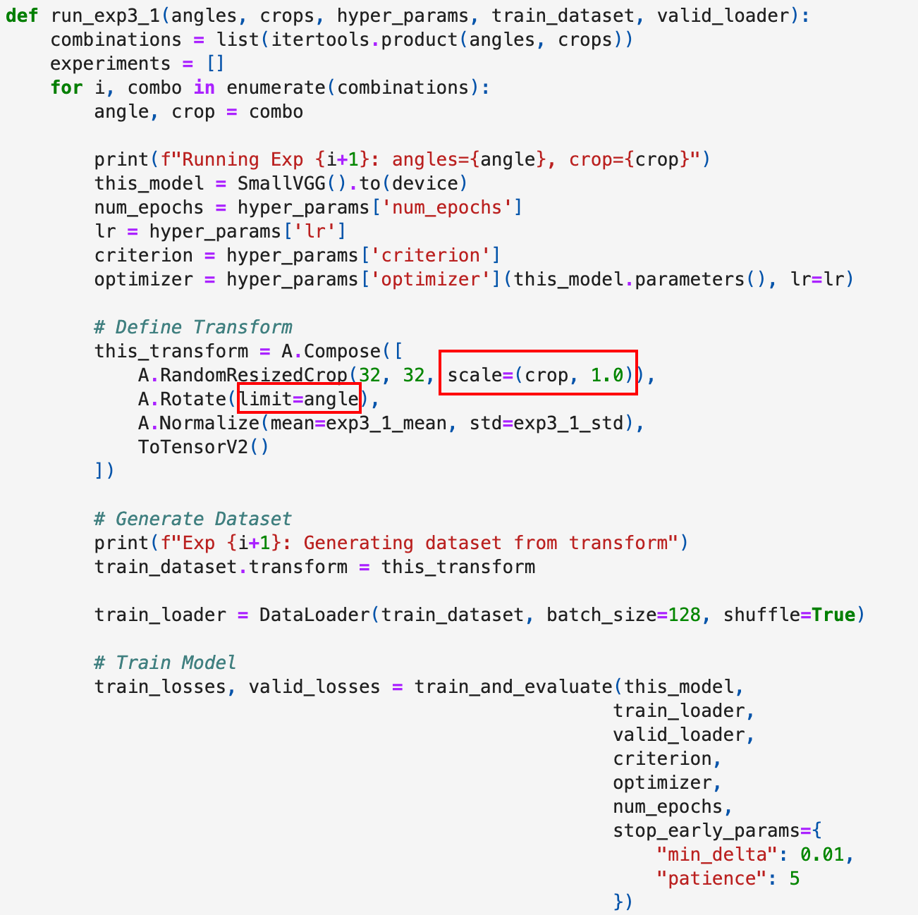
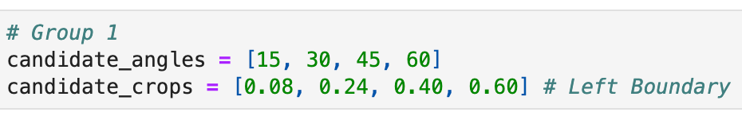
3 Coding Training and Evaluation Functions
3.6 Experiment 3-1(Rotation Angles and Crop Percentages):
Among the 4 deformation parameters we predefined(rotate angle, crop percentage, crop ratio, and contrast factor),
we decided to first use the combination of (Rotation Angles and Crop Percentages) as the target for the first grid search and completed 4x4 sub-experiments.

Slide 19
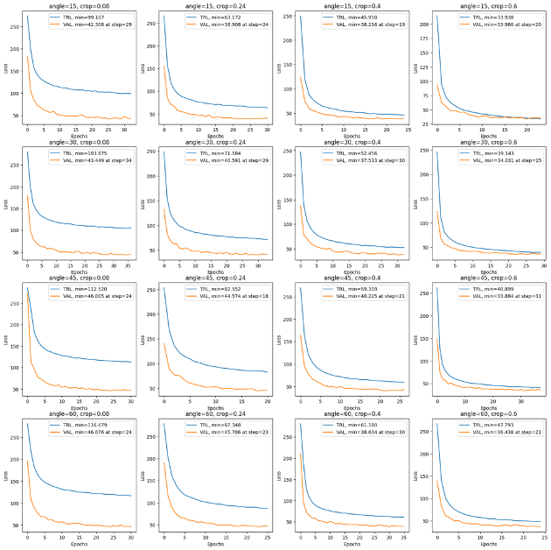
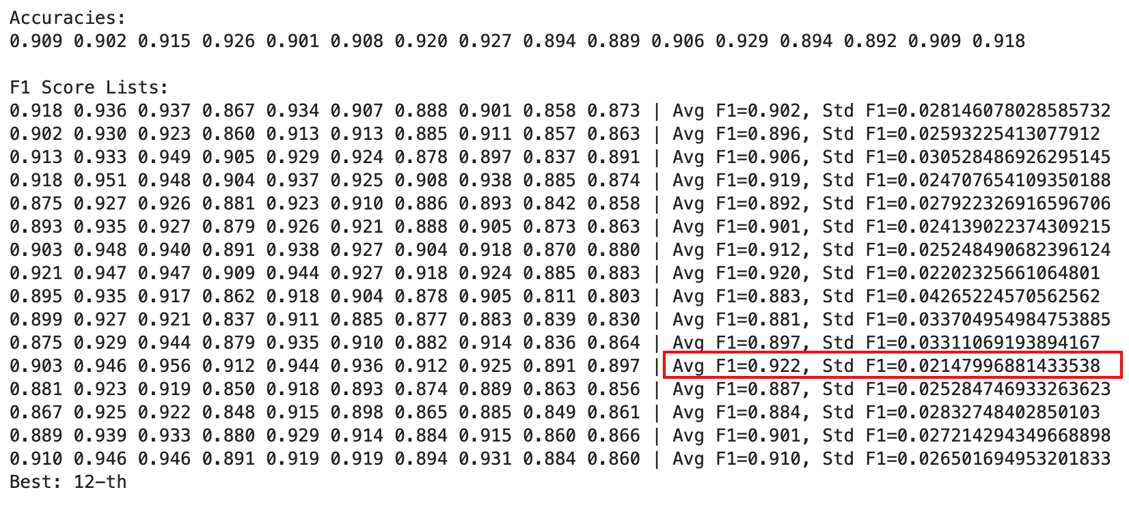
3 Coding Training and Evaluation Functions
3.6 Experiment 3-1(Rotation Angles and Crop Percentages):
Result:
The best result obtained from this experiment is the combination (angle = 45, crop = 0.8), which means that each of our images will be cropped to 0.8 to 1.0 times their original size and then randomly rotated between -45 to 45 degrees. Both random processes follow a uniform distribution.

Slide 20
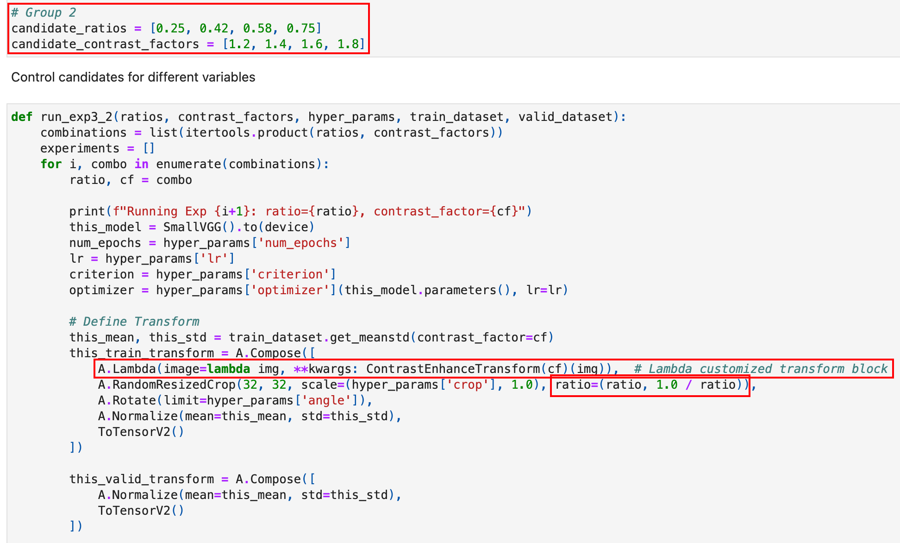
3 Coding Training and Evaluation Functions
3.6 Experiment 3-1(Rotation Angles and Crop Percentages):
For the second set of experiments on transform, we combined aspect ratio and contrast factor, as these 2 hyperparameters have a stronger transformation and generalization capability for images compared to the 3-1 experiment. We used grid search to test and analyze 4x4 combinations separately.
Aspect Ratios: Range of aspect ratios of the random crop. For example, (0.75, 1.3333) allows crop aspect ratios from 3:4 to 4:3. Default: (0.75, 1.3333333333333333)

Slide 21
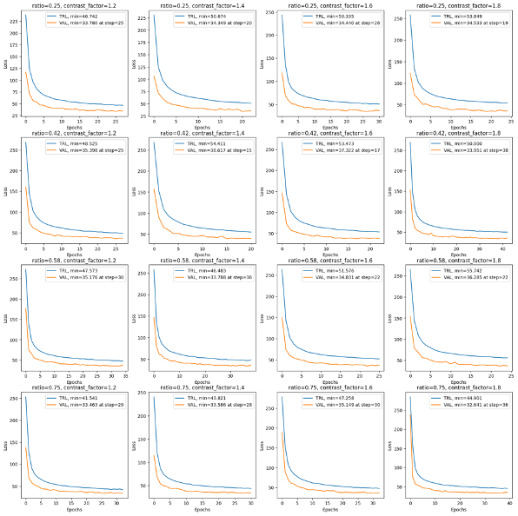
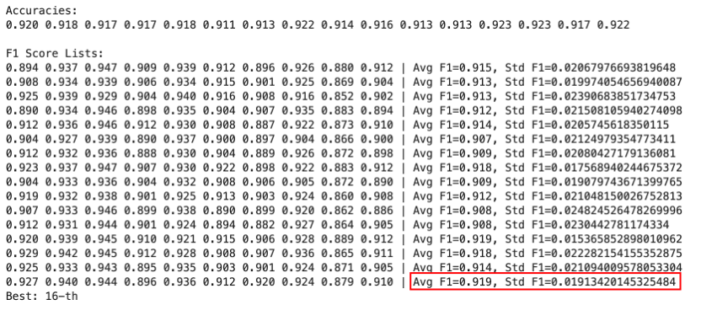
3 Coding Training and Evaluation Functions
3.6 Experiment 3-1(Rotation Angles and Crop Percentages):
Result:
The experiment yielded unexpectedly but reasonably results (aspect ratios = 0.75 & contrast factors = 1.8).
Specifically, this means that the values of all pixels in the images were randomly multiplied by 0.5556 to 1.8 (contrast transform)and clipped within the integer range of [0, 255], while the cropped aspect ratio was between (3/4, 4/3).
We believe that a high contrast factor allows the model to better recognize data under different lighting conditions, leading to a more fitting effect.

Slide 22
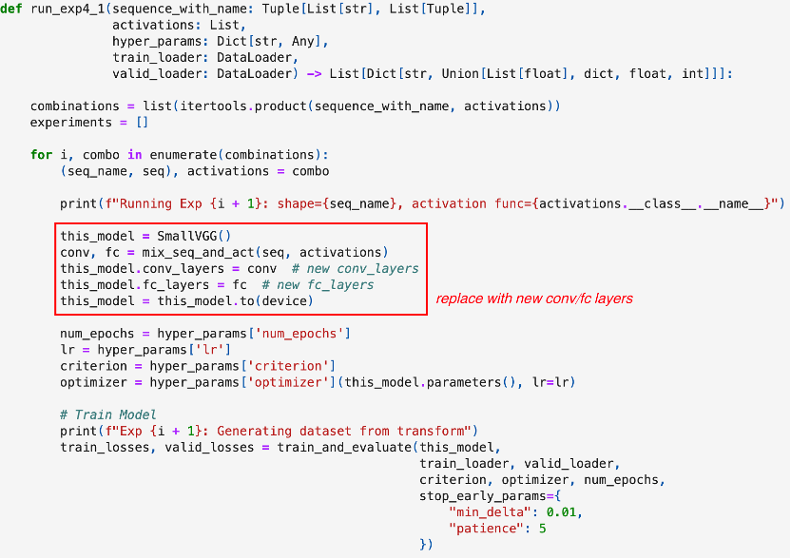
3 Coding Training and Evaluation Functions
3.7 Experiment 4-1(NN Structure):
In the final phase of the project, we tried various types of neural network architectures: VGG, LeNet-5, 2012 AlexNet, and 2014 GoogLeNet (their structures and code are presented below).
We also used four different activation functions (ReLU, ELU, Leaky ReLU, and SiLU), resulting in 4x4=16 groups of neural network structure experiments.
In the coding part, we defined a method mix_seq_and_act(model, activation function) to generate new structure of convolution layer and fc layer.
Different neural networks have their own built-in drop rates.

Slide 23
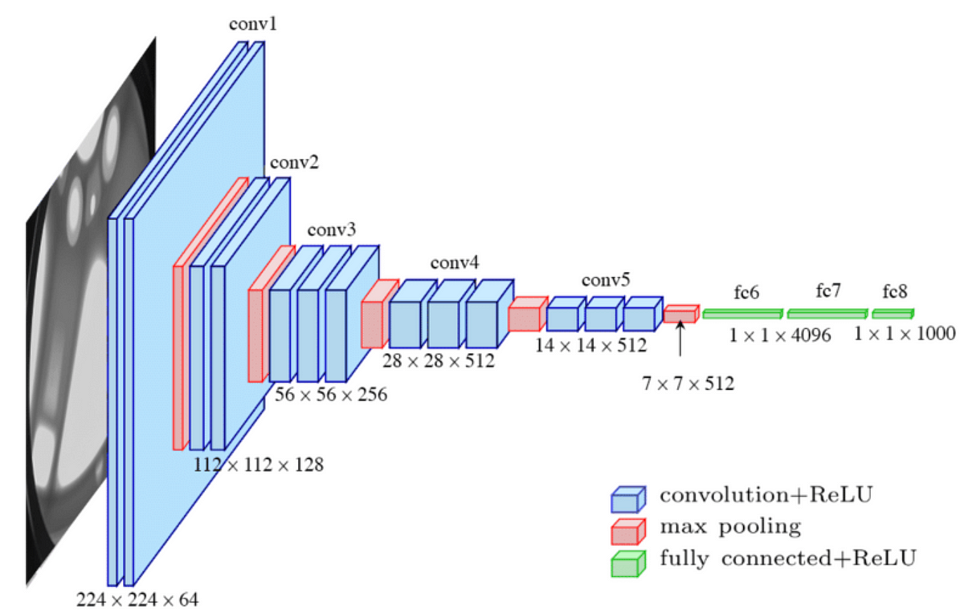
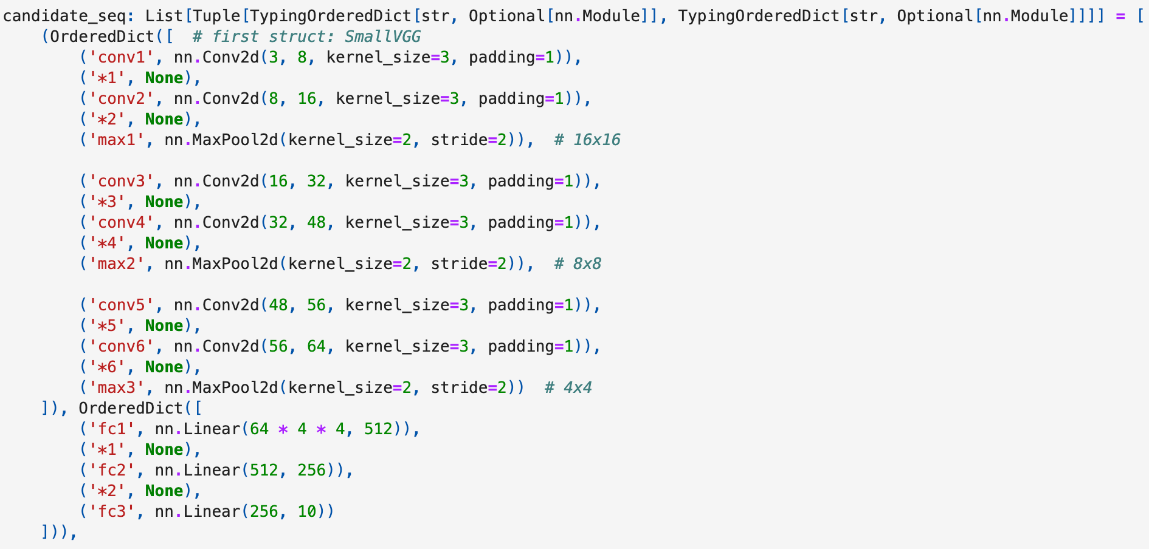
3 Coding Training and Evaluation Functions
3.7 Experiment 4-1(NN Structure): SmallVGG

Slide 24
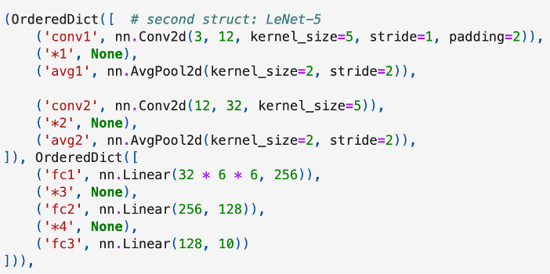
3 Coding Training and Evaluation Functions
3.7 Experiment 4-1(NN Structure): LeNet-5

Slide 25
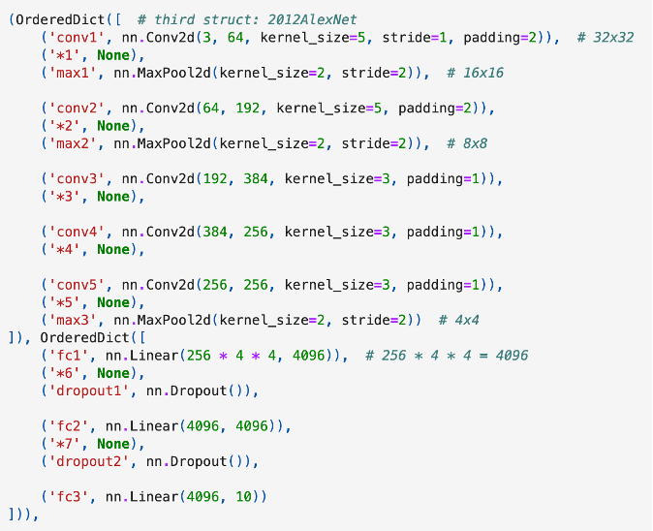
3 Coding Training and Evaluation Functions
3.7 Experiment 4-1(NN Structure): 2012AlexNet

Slide 26
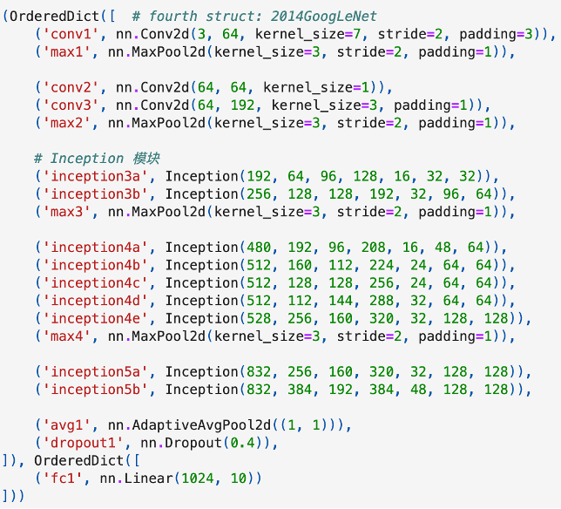
3 Coding Training and Evaluation Functions
3.7 Experiment 4-1(NN Structure): 2014GoogLeNet

Slide 27
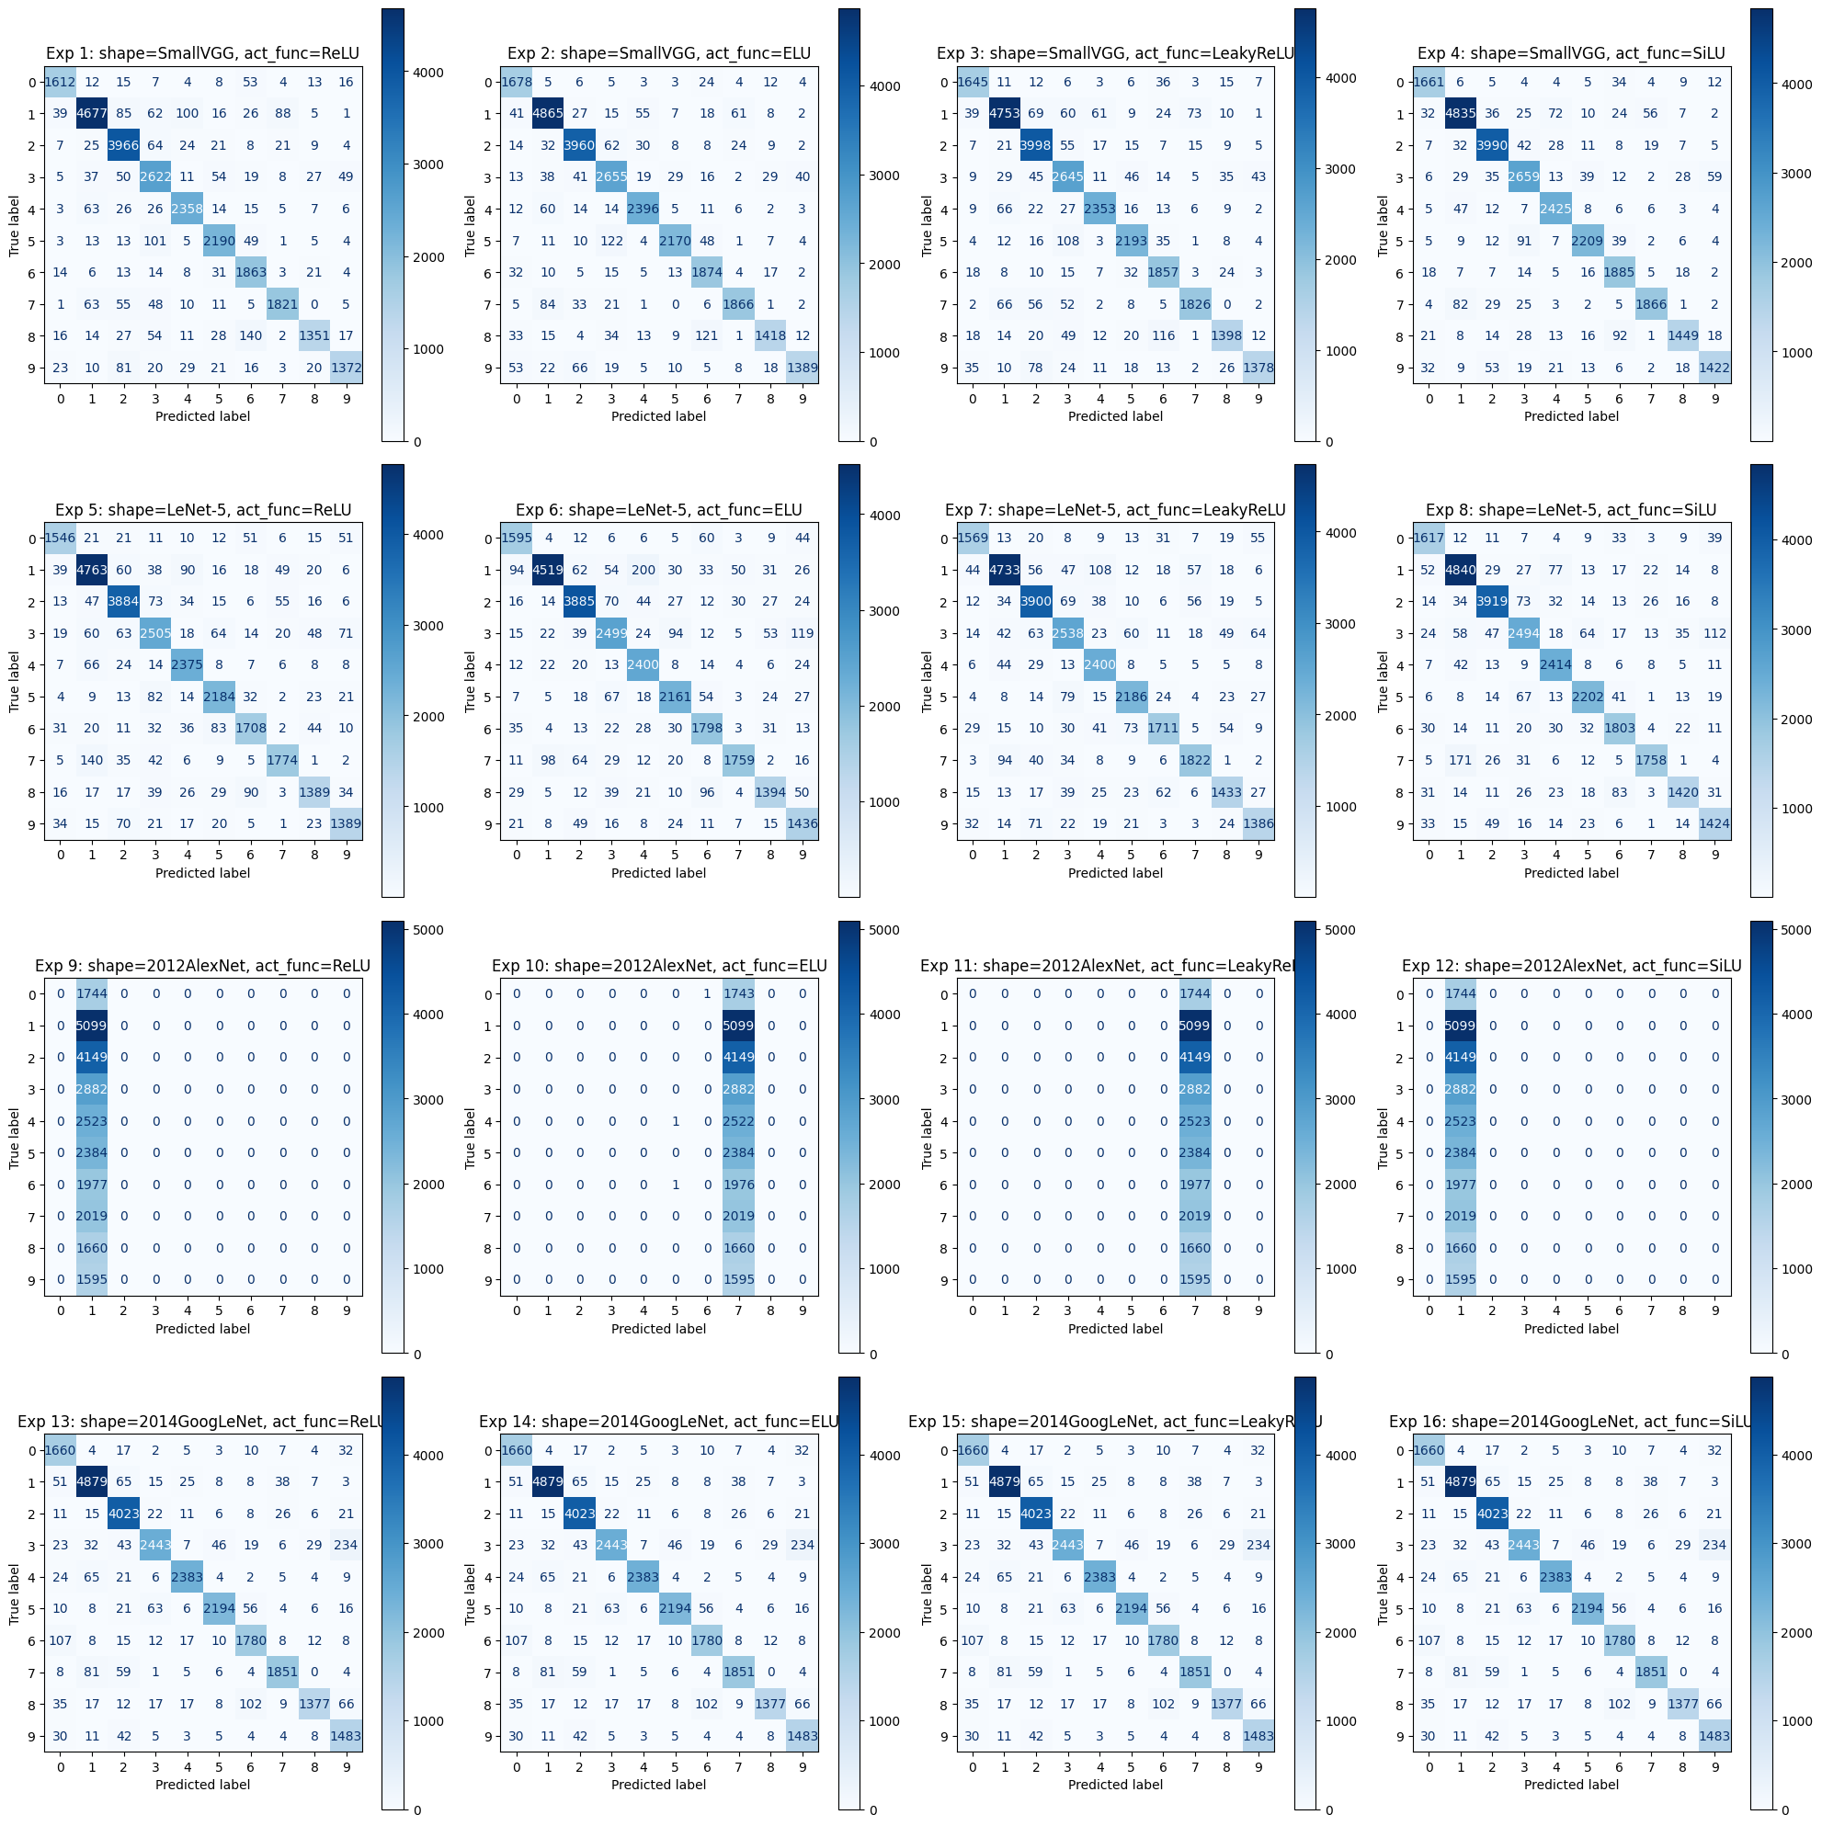
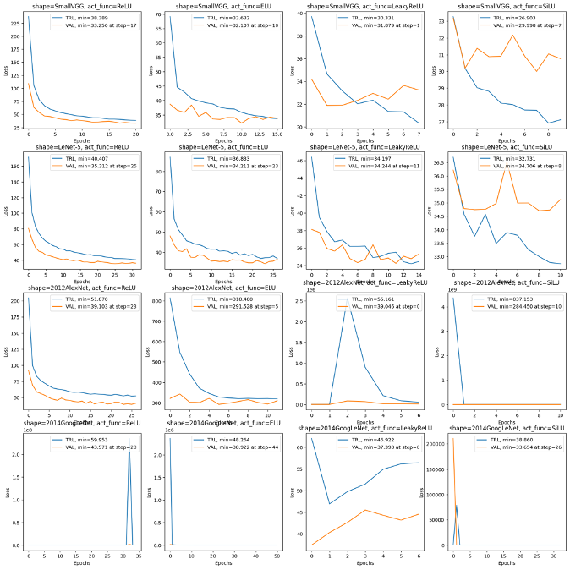
3 Coding Training and Evaluation Functions
3.7 Experiment 4-1(NN Structure):
Result:
(SmallVGG, SiLU) had best performance among all sub-experiments.
In this experiment, we found that SmallVGG is the most stable model during training. Meanwhile, the SiLU activation function allows each model to fit more quickly. However, the downside is that SiLU exhibits significant fluctuations in loss calculation.

Slide 28

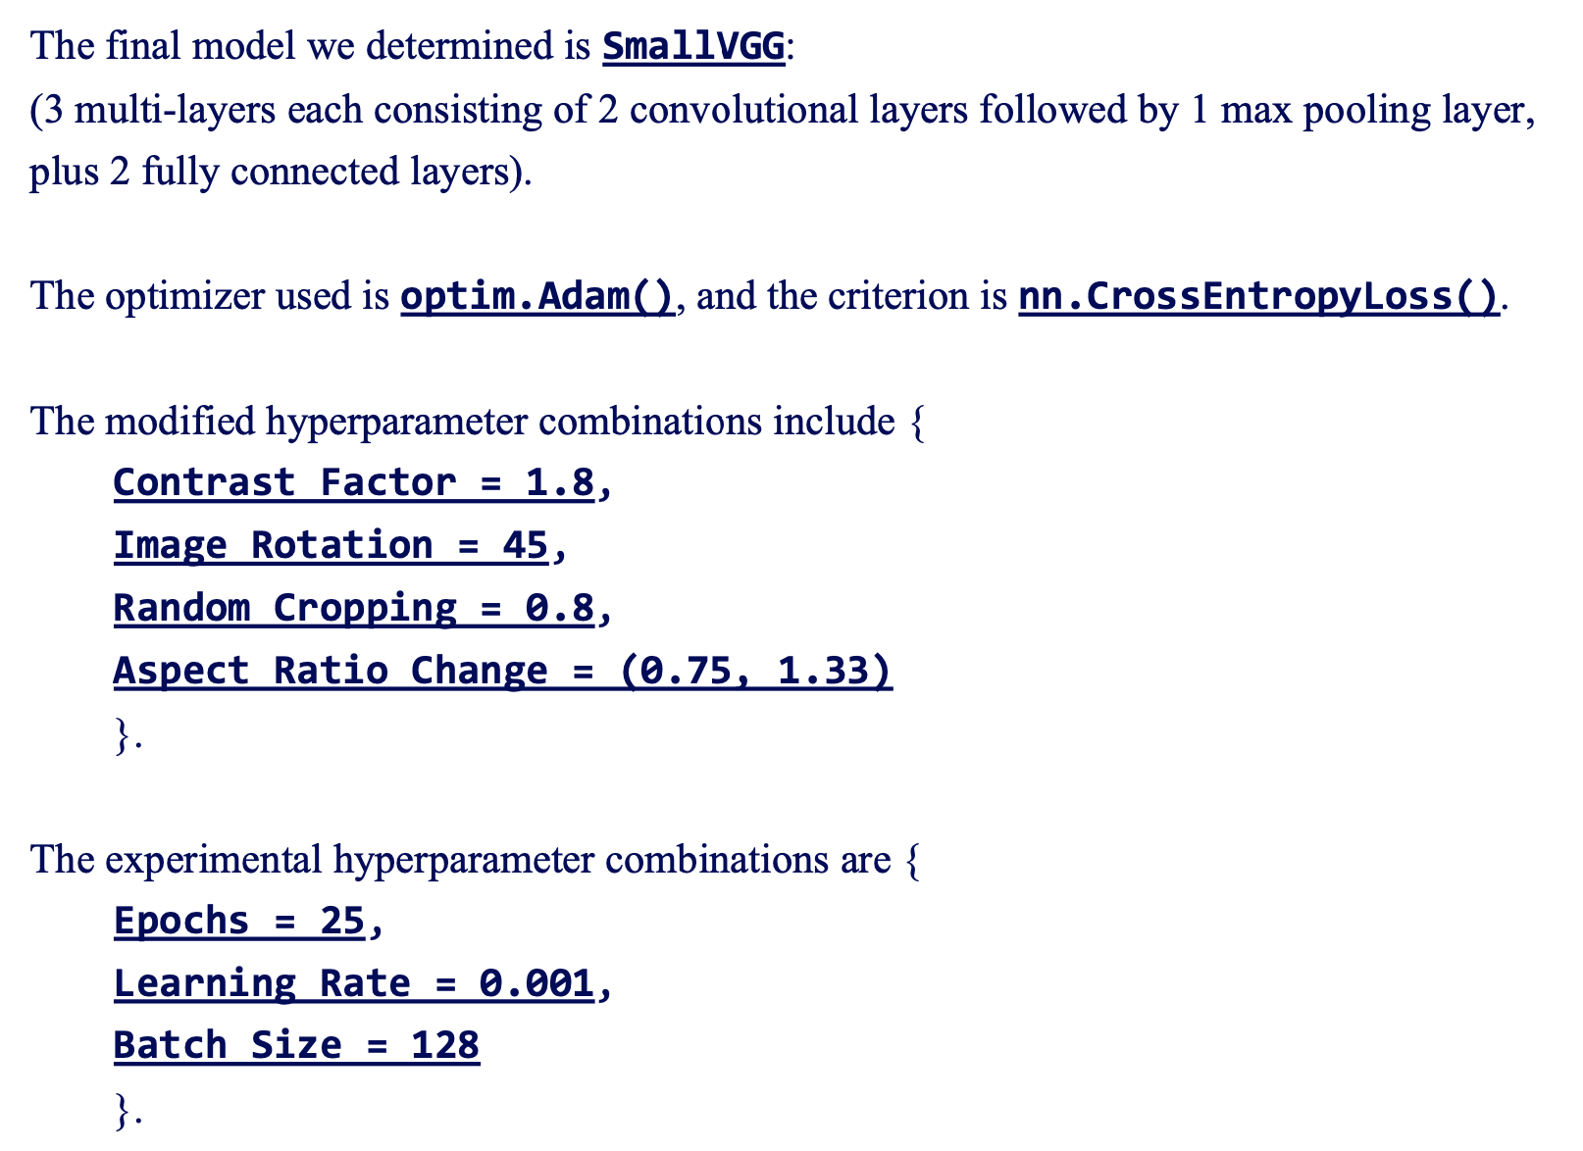
4 Analysis and Conclusion
4.1 Final hyperparameters:

Slide 29

4 Analysis and Conclusion
4.2 Improvement can be done:
Is there anything that needs improvement in each experiment?
The answer is Yes:
We found that grid search is unnecessary in most cases. After brainstorming the tuning order of the parameters, we can conduct individual experiments one by one for each hyperparameters. This approach helps avoid the excessive time costs associated with grid search.
In Experiment 4, we conducted experiments with different types of models. However, we might focus our attention on one specific model, such as SmallVGG, and adjust the number of convolutional layers, fully connected layers, and the quantity of input and output channels. At the same time, we can try different pooling operations (MaxPool, AvgPool, or Adaptive AvgPool) as well as different dropout rates.

Slide 30

4 Analysis and Conclusion
4.2 Improvement can be done:
About Application?
We have saved the trained .pth model, and in future studies, we can use the Gradio library to create an interface for real-time interaction, allowing us to better validate and utilize our training results.

Slide 31
Thank you for listening!

